Slide 1
Java Programming
AWT& Swing
Module 7
Notes:
1

Slide 2
Agenda
1
Introduction to AWT
2
Introduction to Swing
3
Swing Classes and Layout Managers
4
Workshop – Basic GUI
Notes:
2

Slide 3
Objectives
At the end of this module, you will be able to:
Understand the need to develop GUI programming
Know the usage of different AWT containers and components
Identify the need for creating platform-neutral GUI-based applications
Describe various controls and layout managers in Swing

Slide 4
Introduction to AWT

Slide 5
Constructs for AWT Application
An AWT Application requires the following programming constructs :
Containers
Components
Layouts
Events

Slide 6
AWT Containers
A Container is a type of component that provides a rectangular area within which other components can be organized by a LayoutManager.
Because Container is a subclass of Component, a Container can go inside another Container, which can go inside another Container, and so on, like Russian nesting dolls.
Subclassing Container allows you to encapsulate code for the components within it.
This allows you to create reusable higher-level objects easily.
Examples: Window, Frame, Panel, Dialog etc.
Notes:
java.lang.Object
|
+ java.awt.Component
|
java.awt.Container
The components can be added into the container using 5 overloaded add()
Container.add(Component c)
Container.add(Component c, int position) etc
6

Slide 7
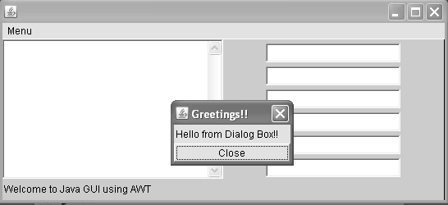
Know your containers
Frame
Window
Dialog
Panel
Panel

Slide 8
Window
A Window is the base display area that contains the frame or applet currently running.
It has no borders, window title, or menu bar that a typical window manager might provide.
A Frame is a subclass of Window that adds these parts (borders, window title).
A Window is by default added along with a frame.
We cannot work directly with Window, we have to pass a Frame object as the parameter to its constructor when creating a new Window
Notes:
Most significant methods of Window
addNotify() – creates the Window’s peer
addWindowListener(WindowListener) – adds the WindowListener object reference to respond to Windows event
show() – shows the window and brings it upfront
toBack() – sends the window to the background of another window
toFront() – brings the window over any other window
pack() – causes the subcomponents of this window to be laid out at their preferred size
dispose() – disposes or destroys the window
8

Slide 9
Panel
A Panel is the basic building block of an applet
It has no physical appearance. It is just a rectangular display area
The Panel class is container subclass that is used to reserve a rectangular portion of a Frame to place other components
This provides a generic container within an existing display area. It is the simplest of all the containers
The default layout for Panel is FlowLayout

Slide 10
Panel example
Panel mypanel = new Panel ();
mypanel.add(new Label ("WIPRO"));
mypanel.add(new Label ("Technologies"));
The above code shows how a Panel object (mypanel) is declared and how the components (Label) are added to it.

Slide 11
Frame
A frame is a window with a title bar and a border
The Frame class is a subclass of Container class
Container class objects may have other components (e.g. Buttons) added to them using the add method
To make a frame visible setVisible(true) or deprecated show() must be invoked by the frame object
The default layout for frame is BorderLayout
Notes:
Most significant methods of Frame
getFrames() – returns an array of Frame class objects
setIconImage(Image image) – sets the image that is to be displayed as an icon of the frame
getIconImage() – shows the image displayed as icon of the frame
setTitle(String title)– sets a title text for the frame
getTitle() – returns the title text as String
setResizable(boolean value) – if set true then the frame can be resized and if false then its not
isResizable() – returns a boolean which indicates whether the frame is resizable
11

Slide 12
Frame example
import java.awt.*;
/*Program to demonstrate AWT Frame*/
public class TestFrame extends Frame {
public TestFrame(String title){
setTitle(title);
}
public static void main(String[] args){
Frame f = new TestFrame("TestFrame");
f.setSize(400,400);
f.setLocation(100,100);
f.setVisible(true);
}
}
Notes:
This program creates a Frame enclosed in a Window. However, if you try to close the Window it will not work unless you handle the WindowEvent.
12

Slide 13
AWT Components
They are reusable gadgets that implement a specific part of the interface.
They are mainly used to capture or display information to and from the end user (for user interaction).
AWT comes with a collection of basic user interface components, along with the machinery for creating your own components (often combinations of the basic components) and for communicating between components and rest of the program.
Examples: Button, Menu, TextField, Checkbox, List etc.
Notes:
Some basic methods of Component class
setBackground(Color cl) – sets the background color/base color of the Component
setForeground(Color cl) – sets the foreground color/font color of the Component
setFont(Font f) – sets the font type of the Component
setName(String name) – sets the name of the Component as specified in the string
setBounds(int x,int y,int width,int height) – sets the dimension of the component according to its params
setBounds(Rectangle r) – sets the dimension of the component according to the rectangle co-ordinates
hide() – this is a deprecated method which hides the component on the container
show() – this is also a deprecated method which sets the component visible on the container
setVisible(boolean b) – if set false it behaves like hide() and if set true then it behaves like show().
Default is setVisible(true).
setSize(int width,int height) – sets the width and height of the component
setLocation(int x,int y) – set the starting point of the component to (x,y)

Slide 14
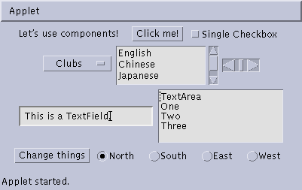
Know your components
Button
Checkbox
Label
Choice
Scrollbar
TextField
List
TextArea
Button
Checkbox
CheckboxGroup
Notes:
Note: The Containers like Window, Dialog, Frame ,Panel etc are also Components as they are derived from the Components but as their parent is Container class they are called as Containers.

Slide 15
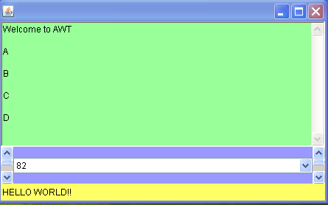
Quiz
From the images below point out the AWT components each marked by One, Two, Three and Four :
One
Two
Three
Four
Notes:
15
Quiz Answers:
One – TextArea
Two – Choice
Three – ScrollBar
Four - Label

Slide 16
Introduction to Swing
Notes:
16

Slide 17
Project JFC
Sun began a project to beef up Java in 1996.
The result was the Java Foundation Classes(JFC) released in 1998.
Swing is the new and improved GUI toolkit included in the JFC.
With Swing, Java can produce highly complex GUIs for industrial strength applications.
Swing components are pure Java components no longer relying on their native peers and are there platform neutral.
The Swing classes and interfaces are present in javax.swing package.
Notes:
Project began in late 1996. Active development has been happening since spring 1997. Beta phase was reached in late 1997. Initial release happened in March 1998 as part of the JFC.
SWING is the codename of the project that first developed the JFC 1.1 components and has been added from JDK1.2 onwards.
javax is an extension package of java which have been added to java throughout its different version development phases.
The javax package in java comes with several important subpackages like
javax.accessibility
javax.annotation
javax.imageio
javax.management
javax.naming
javax.security
javax.swing

Slide 18
Features of Swing
Swing uses:
Lightweight components
A variant of the Model View Controller Architecture (MVC)
Swing has Pluggable Look And Feel (PLAF)
Swing uses the Delegation Event Model
The components can have transparent portions
Components can be any shape, and can overlap each other.
Look and Feel drawn at runtime so can vary.
Functionality is the same on all platforms.
Though slower, Swing is preferred by the industry.
Notes:
Swing has a number of new features to improve GUI design in applications. These are lightweight components, a variant of the Model-View-Controller Architecture (MVC), and Pluggable Look-and-Feel (PLAF). It also uses the Delegation Event Model from JDK 1.1.
Swing fixes these problems by using only Java, no native code, to create components. These are called lightweight components since no peer classes are required. Instead, the components draw themselves on the screen. This self-reliance allows Swing components to do many things their AWT counterparts could not, such as using images on buttons. It also means that widgets not available through the native OS are possible. This is why Swing includes a host of new, highly functional widgets. These Swing components are distinguished by the J-prefix in front of the name (for example, a JButton is a Swing button class).

Slide 19
AWT Limitations
AWT is not functional enough for full scale applications.
The widget library is small
The widgets only have basic functionality
Extensions commonly needed
AWT Components rely on native peers:
Look and Feel tied to operating system
Functionality determined by operating system
Widgets won’t perform exactly the same on different platforms
Faster, because the OS handles the work
Notes:
Java is a relatively new programming language that uses an object-oriented approach that has become popular for developing Internet applications. However Java had a weakness: it lacked sophisticated graphic user interface (GUI) components needed to make large-scale windowing applications. Java did have a GUI toolkit: the Abstract Window Toolkit (AWT), but it was not functional enough for full-scale graphic applications. The widget library was small and contained only the most basic of components. Those components only had basic functionality (such as buttons that could only have text labels not images). This meant that developers who wanted more had to spend considerable time creating classes to extend the functionality of the widgets provided by the AWT. In the fast-moving world of software development, this was a serious waste of resources. Also, the AWT components relied on native peers which meant that portability was hampered by minor differences in the way each operating system handled a particular widget, and the look-and-feel of the components was governed by the native operating system (OS).

Slide 20
Notes:
One of the weaknesses of the AWT is its use of heavyweight components. These are widgets which rely on native peers for their look-and-feel. These peer classes are linked to corresponding widgets and are responsible for talking to the native operating system. They tell that operating system to create the widget, so it has the same appearance as a native one. This is why an AWT button on a Windows platform looks different from the same button displayed on a Mac. This reliance on the native OS proves troublesome for a number of reasons. Since the developer has no direct control over the look of components, changing the look of components is difficult. Also, Peer-driven widgets may behave differently depending on the platform. These differences are slight, but if they are a problem for the developer, they may require complex code to fix. This is one of the reasons that the AWT components have only basic functionality. More complex abilities would be too difficult to implement cross-platform. Since native peers are required, a common, cross-platform look & feel is impossible. This makes it awkward for developers who want their software to run on other platforms as documentation and testing have to be done for each OS they want to use. This would not be such a problem except that one of Java’s strengths, that it is a cross-platform language.

Slide 21
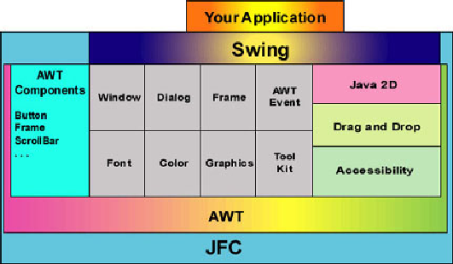
Java Foundation Classes
AWT
Swing
Accessibility
2D API
Drag and Drop
Notes:
The Java Foundation Classes are Sun's answer to Java's deficiencies. They were released in March 1998 and contained five main elements: Java2d, Accessibility, Drag and Drop, AWT, and Swing. Java2d has classes for more complex use of painting, shape, color, and fonts. Accessibility is a set of tools for implementing support for physically challenged users in an application that use non-traditional means for input and output. Drag and Drop is an API which allows GUI objects to be "dragged" via the mouse from one part of an application to another, between Java applications, or even between Java and other applications. The AWT is the original one from Java and is included to support code that already uses the AWT. In this module we will primarily focus on Swing. Swing is designed for forms-based applications development. It provides a rich set of components and a framework to specify how to present GUIs that are visually independent of the platform.

Slide 22
Lightweight vs Heavyweight
AWT Components
AWT components are dependant on native components
In order to display an awt button the awt will use native peer classes to communicate with the os-specific native class for button, and then fetch the characteristics from it
Hence the look and feel changes according to platform
This results in more memory usage
Hence the components in AWT are called Heavyweight
SWING Components
Swing components are written purely in java, hence they do not require the native component features
A swing button will use its predefied characteristics and display the same across all platforms
The Swing components exhaust less memory space
Hence the components in Swing are called Lightweight

Slide 23
Activity
List 4 differences between AWT and Swing in a tabular format
AWT | SWING

Slide 24
PLAF Features in Swing
The PLAF:
has a default Metal style
can emulate Motif, and Windows styles
supports Mac style through download
can be used to design new styles
can be reset at runtime
Notes:
Because of the Model-Delegate architecture, and its separation of model and appearance, Swing is able to implement a new feature: Pluggable Look-and-Feel. This feature allows the entire component tree of an application to take on a new visual representation. The UI-delegate is changed so that the appearance changes even though the Model remains the same. It is called pluggable because the look-and-feel can be set at any time. This means that an application can change its look-and-feel during execution. There are three look-and-feel options that are included in Swing. The default Metal Look-and-Feel (also known as Java Look-and-Feel) is used if no other style is set or if the specified style cannot be used due to an error. It can run in any environment. The Windows Look-and-Feel mimics the design of Windows widgets. It can be used only on Microsoft Windows platforms. Third, the Motif Look-and-Feel (or CDE) has the same style as the OSF/Motif 1.2.5 Unix environment. It can be run on any platform. There is also a Macintosh Look-and-Feel currently available for download. In addition, developers can create a new look-and-feel of their own.

Slide 25
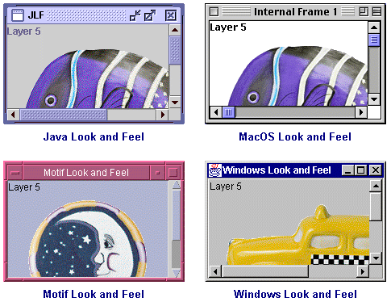
PLAF Examples
Notes:
As mentioned before, all components have an abstract UI delegate in the swing plaf package. This delegate is named using the convention of removing the J-prefix and adding the suffix UI (JButton has UI delegate ButtonUI). This UI delegate is accessed by the get/setUI() methods. All components have an abstract UI delegate in the swing.plaf package (Jbutton - ButtonUI). UI delegate is accessed by get/setUI() method. Each Look and Feel has a concrete class for each abstract UI delegate (WindowsButtonUI)
communicate through UIManager class
get/setLookAndFeel()

Slide 26
Swing Classes and Layout Managers
Notes:
26

Slide 27
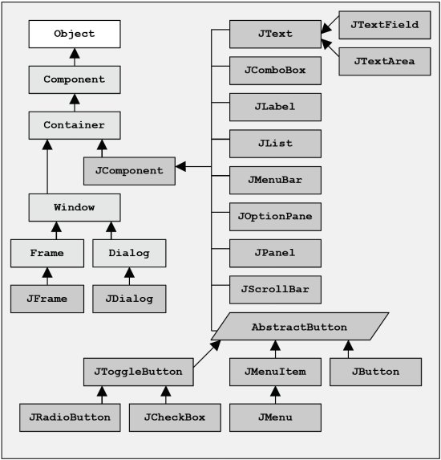
Swing Class Hierarchy
Notes:
Image Reference: “http://www.particle.kth.se/~lindsey/JavaCourse/Book/Part1/Java/Chapter06/swing.html”
The rectangles in light shade are AWT classes belonging to java.awt package. For example Component, Container, Window etc
The rectangles in dark shade are Swing classes belonging to javax.swing package. For example JComponent, JDialog, JFrame etc.

Slide 28
Swing Program Constructs
Swing applications have the following basic constituents:
Component
Container
Layout
Event

Slide 29
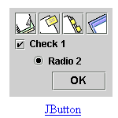
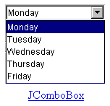
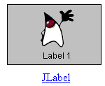

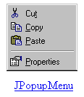
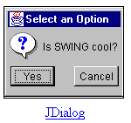
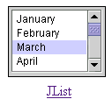
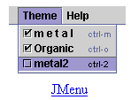
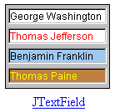

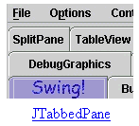
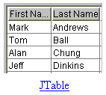
Swing Components
Notes:
JComponent is the common root of most of the Swing GUI classes. It provides the guiding framework for GUI objects. It extends java.awt.Container class, and other objects (components) can be added to it. The JComponent class extends the Container class, which itself extends Component. The Component class includes everything from providing layout hints to supporting painting and events. The Container class has support for adding components to the container and laying them out.
JComponent Features: Few of the functionality provided by JComponent class to its descendants are:
Tool tips by specifying a string with the setToolTipText( ) method –
you can provide help to users of a component. When the cursor pauses over the component, the specified string is displayed in a small window that appears near the component.
Borders - The setBorder( ) method allows you to specify the border that a component displays around its edges.
Keyboard-generated actions - Using the registerKeyboardAction( ) method, you can enable the user to use the keyboard, instead of the mouse, to operate the GUI. The combination of character and modifier keys that the user must press to start an action is represented by a KeyStroke object. The resulting action event must be handled by an ActionListener.

Slide 30
Notes:
30
Application-wide Pluggable Look and Feel: Behind the scenes, each JComponent object has a corresponding ComponentUI object that performs all the drawing, event handling, size determination, and so on for that JComponent. Exactly which ComponentUI object is used depends on the current look and feel, which you can set using the UIManager.setLookAndFeel( ) method.
Properties: You can associate one or more properties (name/object pairs) with any JComponent. For example, a layout manager might use properties to associate a constraints object with each JComponent it manages. You put and get properties using the putClientProperty( ) and getClientProperty( ) methods.

Slide 31
Methods Inherited from Component Class
get/setBackground()
is/setEnabled()
get/setFont()
get/setForeground()
get/setLayout()
get/setLocationOnScreen()
get/setName()
get/setParent()
is/setVisible()

Slide 32
New Methods
get/setBorder()
is/setDoubleBuffered()
getGraphics()
get/setToolTipText()
add()
remove()
pack()
get/setBounds()
get/setSize()
get/setLocation()
get/setWidth()
get/setHeight()
get/setMaximumSize()
get/setMinimumSize()
get/setPreferredSize()
Notes:
Methods to increase efficiency: JComponent has few methods that provide more efficient ways to get information than the JDK 1.1 API allowed. The methods include getX( ) and getY( ), which you can use instead of getLocation( ); and getWidth( ) and getHeight( ), which you can use instead of getSize( ). It also adds one argument forms of getBounds( ), getLocation( ), and getSize( ) for which you specify the object to be modified and returned, letting you avoid unnecessary object creation. These methods have been added to Component for Java 2 (JDK 1.2).

Slide 33
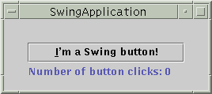
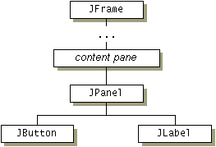
Swing Component & Containment Hierarchy
Notes:
Even the simplest Swing program like the one in slide will have multiple levels in its containment hierarchy. The root of the containment hierarchy is always a top-level container. The top-level container provides a place for its descendent Swing components to paint themselves. The frame is a top-level container. It exists mainly to provide a place for other Swing components to paint themselves. The other commonly used top-level containers are dialogs (JDialog) and applets (JApplet). The panel is an intermediate container. Its only purpose is to simplify the positioning of the button and label. Other intermediate Swing containers, such as scroll panes (JScrollPane) and tabbed panes (JTabbedPane), typically play a more visible, interactive role in a program's GUI. The button and label are atomic components -- components that exist not to hold random Swing components, but as self-sufficient entities that present bits of information to the user. Often, atomic components also get input from the user. The Swing API provides many atomic components, including combo boxes (JComboBox), text fields (JTextField), and tables (JTable).
Adding Components to Containers
frame = new JFrame(...);
button = new JButton(...);
label = new JLabel(...);
pane = new JPanel();
pane.add(button);
pane.add(label);
frame.getContentPane().add(pane,BorderLayout.CENTER);

Slide 34
JButton
Extends abstract class javax.swing.AbstractButton
Behaves like an AWT Button and usually has ActionListener responding against the button press event (ActionEvent)
Image can be set using ImageIcon object
Can also display the effects set using HTML tags, passed as JButton text
Declaration:
JButton mybutton1=new JButton(“CLICK”);
mubutton1.setForeground( Color.WHITE );
mybutton1.setBackground( Color.BLACK );
String str="<html><body bgcolor = black>" +
"<font color=white>CLICK" +
"</font></body></html>";
JButton mybutton2=new JButton( str );
Notes:
In the first declaration a button is created with the label “CLICK”. Its foreground and background colors are set to WHITE and BLACK respectively with the help of relevant JButton methods setForeground and setBackGround.
The same can be done by using HTML tags as shown in the next case. The HTML tags specify the Button Label’s foreground and background color to be white and black respectively. This is an added functionality available only in swing components.

Slide 35
JToggleButton, JCheckBox, JRadioButton
JToggleButton define a button with two states- pressed or not
JToggleButton has inherited javax.swing.AbstractButton
JCheckBox and JRadioButton inherits the JToggleButton
JCheckBox create objects with a square box that can be selected
Used for multiple selection
JRadioButton create objects with a round shape that can be grouped under java.awt.ButtonGroup so that only one in the group can be selected at a time
Used for single selection
Both JCheckBox and JRadioButton selections are ItemEvent objects and can be handled by ItemListener
Notes:
JCheckBox Example :
JCheckBox fruit1=new JCheckBox(“Apple”);
JCheckBox fruit2=new JCheckBox(“Banana”);
JCheckBox fruit3=new JCheckBox(“Mango”);
Since, they are not grouped together only one or multiple can be selected.
JRadioButton Example :
JRadioButton male=new JRadioButton(“Male”);
JRadioButton female=new JRadioButton(“Female”);
ButtonGroup gender=new ButtonGroup();
gender.add(male);
gender.add(female);
If the radiobuttons are not grouped under ButtonGroup, then both are selectable.

Slide 36
JTextField, JTextArea, JPasswordField, JLabel
JTextField provides a single line text box for user entry
Number of characters can be restricted by providing the value along with its constructor while object declaration
JTextArea allows editing multiple lines whose row and columns can be set
A default scroll pane with scrollbars appear as the text exceeds the current view area
JPasswordField provides a single line text box just like JTextField but the typed characters are replaced by the masking character. Used for entering password
The masking character can be set by setEchoChar()
Default is ‘*’
JLabel provides a static text display area which is not editable by the user.
Images can be set using setIcon()
Notes:
Common Methods :
The above classes have some methods in common
setText() can set a string value to the component
getText() returns a string value from the component

Slide 37
JComboBox and JList
JComboBox
- JComboBox is also known as drop down list
- Provides a list of choices from where a single or multiple can be selected
- We can add elements using addItem()
- We can remove elements by objectname using removeItem()
- We can remove elements by index using removeItemAt()
- removeAllItems() remove all the elements a one go
JList
- JList like a combo box provides list of choices from where single or multiple elements are selectable
- Elements are listed in multiple lines
- Wrapped in a scroll pane
- We can add components using add()
- We can remove elements by index using remove()
- removeAll() remove all the components a one go
Notes:
Both JComboBox and JList selections are ItemEvent objects and can be handled by ItemListener

Slide 38
JOptionPane & Modal Dialogs
JOptionPane provides several static methods using which different type of modal dialog boxes can be created
It can create input dialog, message dialog, option dialog, confirm dialog, internal input dialog, internal message dialog and internal confirm dialog.
Its static methods are:
showMessageDialog()
showConfirmDialog()
showOptionDialog()

Slide 39
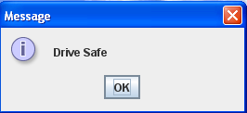
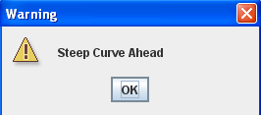
JOptionPane & Modal Dialogs (Contd.).
Code | Output
JOptionPane.showMessageDialog ( frame, "Drive Safe“ );
JOptionPane.showMessageDialog( frame, "Steep Curve Ahead", "Warning", JOptionPane.WARNING_MESSAGE );
Notes:
39
JOptionPane.showMessageDialog ( frame, "Drive Safe“ );
JOptionPane.showMessageDialog( frame, "Steep Curve Ahead", "Warning", JOptionPane.WARNING_MESSAGE );

Slide 40
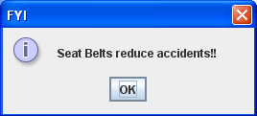
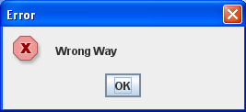
JOptionPane & Modal Dialogs (Contd.).
Code | Output
JOptionPane.showMessageDialog( frame, "Seat Belts reduce accidents!!", "FYI", JOptionPane.INFORMATION_MESSAGE );
JOptionPane.showMessageDialog( frame, "Wrong Way", "Error",JOptionPane.ERROR_MESSAGE);
Notes:
40
JOptionPane.showMessageDialog( frame, "Seat Belts reduce accidents!!", "FYI", JOptionPane.INFORMATION_MESSAGE );
JOptionPane.showMessageDialog( frame, "Wrong Way", "Error",JOptionPane.ERROR_MESSAGE);

Slide 41
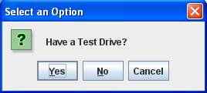
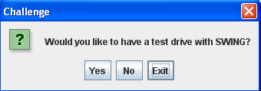
JOptionPane & Modal Dialogs (Contd.).
Code | Output
JOptionPane.showConfirmDialog( frame, "Have a Test Drive?“ );
Object obj[]={"Yes","No","Exit"}; JOptionPane.showOptionDialog( frame, "Would you like to have a test drive with SWING?", "Challenge", JOptionPane.YES_NO_CANCEL_OPTION, JOptionPane.QUESTION_MESSAGE, null, obj, obj[2] );
Notes:
41
JOptionPane.showConfirmDialog( frame, "Have a Test Drive?“ );
Object obj[]={"Yes","No","Exit"};
JOptionPane.showOptionDialog( frame, "Would you like to have a test drive with SWING?", "Challenge", JOptionPane.YES_NO_CANCEL_OPTION, JOptionPane.QUESTION_MESSAGE, null, obj, obj[2] );

Slide 42
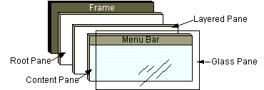
Root Panes
Notes:
42
In general, we don't directly create a JRootPane object. Instead, we get a
JRootPane (whether we want it or not!) when we instantiate one of the top-
level Swing containers, such as JApplet, JDialog, and JFrame.
Root pane has four parts:
The glass pane: Hidden, by default. If you make the glass pane visible, then it's like a sheet of glass over all the other parts of the root pane. It's completely transparent unless you implement the glass pane's paint method so that it does something, and it intercepts input events for the root pane.
The layered pane: Serves to position its contents, which consist of the content pane and the optional menu bar. Can also hold other components in a specified order.
The content pane: The container of the root pane's visible components, excluding the menu bar.
The optional menu bar: The home for the root pane's container's menus. If the container has a menu bar, you generally use the container's setJMenuBar( ) method to put the menu bar in the appropriate place.

Slide 43
JScrollPane and JScrollBar
JScrollPane increases the view scope of any component beyond the screen size
The pane is accompanied by scroll bars
The JScrollBar helps to browse areas in the scroll pane beyond the screen limit
The scroll bars are of 2 types – vertical and horizontal
Scroll bar policies can be set when scroll panes are declared or dynamically using setHorizontalScrollBarPolicy and setVerticalScrollBarPolicy methods
The scroll bar policies are integer constants that are passed as parameter to scroll pane constructor
Notes:
43
Scroll Pane Policies :
VERTICAL_SCROLLBAR_AS_NEEDED and HORIZONTAL_SCROLLBAR_AS_NEEDED – this is default. When the viewport is smaller than the component area then they appear, when its smaller they disappear.
VERTICAL_SCROLLBAR_ALWAYS and HORIZONTAL_SCROLLBAR_ALWAYS – always displays the scrollbar. The scrollbar becomes fixed if viewport is same or more than the component area.
VERTICAL_SCROLLBAR_NEVER and HORIZONTAL_SCROLLBAR_NEVER – prevents the scrollbar to appear even when its having smaller viewport.
Note: Scroll events can be handled by AdjustmentListener

Slide 44
Swing Containers
Swing containers provide a rectangular area where the widgets can be arranged into with the help of LayoutManager.
All the Swing containers have been inherited from java.awt.Container class.
JWindow
Extends java.awt.Window
Form a rectangular area without title bar and window management icons
Encloses JFrame by default
This can be used for creating a subsidiary window in the application
Notes:
44

Slide 45
Swing Containers (Contd.).
JFrame
Extends java.awt.Frame
Has title bar, border, window management icon and provision to include a menu
Other components can be added
This is the basic building block of java GUI
setDefaultCloseOperation() sets the operations that happen when user clicks on the close button on top right side of the frame
Notes:
45

Slide 46
Swing Containers (Contd.).
JFrame (continued)
The following constants can be passed as this method’s parameter
DO_NOTHING_ON_CLOSE - no action will be taken
HIDE_ON_CLOSE – will hide the frame
DISPOSE_ON_CLOSE – will hide and destroy the frame
EXIT_ON_CLOSE – will stop and close the application invoking System.exit()
JDialog
Extends java.awt.Dialog
Pops up modal dialog window for user interaction
Must have parent JFrame
This can be used for displaying messages in a program or for taking user inputs
Notes:
46

Slide 47
Layout Managers
Arrange widgets according to a pattern
Can update containers to handle resizing of the container or internal widgets
Make complex UIs possible
Provide a compact representation of the UI
All layout manager classes have implemented java.awt.LayoutManager interface
Notes:
47
Layout management is the process of determining the size and position of components. By default, each container has a layout manager -- an object that performs layout management for the components within the container. Components can provide size and alignment hints to layout managers, but layout managers have the final say on the size and position of those components.

Slide 48
Layout Manager Types
These are the list of Layout Managers
Layout Manager | Description
BorderLayout | Arranges components along the north, south, east, west, and in the center of the container.
CardLayout | Arranges components like a stack of cards, with one visible at a time.
FlowLayout | Arranges components left to right across the container.
GridLayout | Arranges components into a two-dimensional grid of equally sized cells.
GridBagLayout | Arranges components in a grid of variable sized cells (complicated).
Notes:
48

Slide 49
Flow Layout
Arranges components from left to right and top to bottom
Fits as many components in a row as possible before making a new row
Lets you specify alignment, horizontal and vertical spacing
1
2
3
4
5
Notes:
49
FlowLayout puts components in a row, sized at their preferred size. If the
horizontal space in the container is too small to put all the components in one row, FlowLayout uses multiple rows. Within each row, components are
centered (the default), left-aligned, or right-aligned as specified when the
FlowLayout is created.
Example:
toolbar.setLayout(new FlowLayout(FlowLayout.LEFT));
toolbar.add(playButton);
toolbar.add(stopButton);

Slide 50
Border Layout
Arranges components according to specified edges or the middle
NORTH
SOUTH
EAST
WEST
CENTER
Lets you specify horizontal and vertical spacing
contentPanel.setLayout(new BorderLayout(0, 0));
contentPanel.add("Center", oPanel);
contentPanel.add("South", controlPanel);
N
C
W
E
S
Notes:
50
A BorderLayout has five areas: north, south, east, west, and center. If you enlarge the window, the center area gets as much of the available space as possible. The areas expand only as much as necessary to fill all available space. Often, a container uses only one or two of the areas of the BorderLayout --just the center, or center and south.
For example,
Container contentPane = getContentPane();
//Use the content pane's default BorderLayout.
//contentPane.setLayout(new BorderLayout()); //unnecessary
contentPane.add(new JButton("Button 1 (NORTH)"), BorderLayout.NORTH);
contentPane.add(new JButton(“CENTER”), BorderLayout.CENTER);
contentPane.add(new JButton(“WEST"), BorderLayout.WEST);
contentPane.add(new JButton("Long-Named Button 4 (SOUTH)"), BorderLayout.SOUTH);
contentPane.add(new JButton("Button 5 (EAST)"), BorderLayout.EAST);

Slide 51
Grid Layout
Arranges components in a grid with specified rows and columns
rows have same height and columns have same width
contentPanel.setLayout(new GridLayout(2, 4));
contentPanel.add(startButton);
contentPanel.add(stopButton);
0,0
0,1
0,2
1,1
1,3
Notes:
51
A GridLayout places components in a grid of cells. Each component takes all the available space within its cell, and each cell is exactly the same size. If you resize the GridLayout window, you'll see that the GridLayout changes the cell size so that the cells are as large as possible, given the space available to the container. Example:
Container contentPane = getContentPane();
contentPane.setLayout(new GridLayout(0,2));
contentPane.add(new Button("Button 1"));
contentPane.add(new Button("2"));
contentPane.add(new Button("Button 3"));
ContentPane.add(new Button("Long-Named Button 4"));
contentPane.add(new JButton("Button 5"));
The constructor tells the GridLayout class to create an instance that has two columns and as many rows as necessary.

Slide 52
Quiz
Map the Layout Managers with their arrangement of Components
Group A
(Layout Managers)
FlowLayout
CardLayout
GridLayout
BorderLayout
Group B
(Arrangement of Components)
NORTH,EAST,WEST,CENTER and SOUTH arrangement
Tabular arrangement
Left to right across the screen
Like a stack from where one can be displayed at a time
Notes:
52
Quiz Answers:
A1 – B3
A2 – B4
A3 – B1
A4 – B2

Slide 53
Default Layout Managers
In AWT, the default layout for applets was FlowLayout.
Container Layout Manager
JApplet BorderLayout (on its content pane)
JBox BoxLayout
JDialog BorderLayout (on its content pane)
JFrame BorderLayout (on its content pane)
JPanel FlowLayout
JWindow BorderLayout (on its content pane)
Top-level windows use BorderLayout
Notes:
53

Slide 54
Quiz
Match the components :
JToggleButton
JRadioButton
JScrollBar
JComboBox
JOptionPane
Drop down list
showConfirmDialog()
Same window space shared by multiple components
Button with 2 states
Under ButtonGroup
For browsing beyond the screen limit
Notes:
54
Quiz Answers :
1 – D
2 – E
3 – F
4 – A
5 – C

Slide 55
Workshop – Basic GUI

Slide 56
Case Study: Designing a Basic GUI
Basic User Interface Tasks:
Provide help/guidance to the user
Allow input of information
Allow output of information
Control interaction between the user and device
Problem Description: Design a GUI for a Java application that converts miles to kilometers. Write the class that performs the conversions.
Swing objects for:
Guidance
Input
Output
Control
Notes:
Class to convert miles to kilometers:
public class MetricConverter {
public static double milesToKm(double miles) {
return miles / 0.62;
}
}
Guidance: A JLabel displays a short string of text or an image. It can serve as a prompt.
Input: A JTextField allows editing of a single line of text. It can get the user’s input.
Output: A JTextArea allows editing of multiple lines of text. We’ll use it to display results.
Control: A JButton is an action control. By implementing the ActionListener interface we will handle the user's action events.
GUI Design: The Top-Level Window
For applets, top-level window is JApplet. For applications, a JFrame is used. Both JApplet and JFrame are subclasses of Container and are suitable for holding the interface components. Both JApplet and JFrame are lightweight components.

Slide 57
GUI Design: Layout
*
**
Notes:
In a FlowLayout components are arranged left to right in rows within the container. The top-level window is a JFrame. The containment hierarchy shows which components are contained in containers.

Slide 58
Implementing the Converter Class
import javax.swing.*;
import java.awt.*;
import java.awt.event.*;
public class Converter extends JFrame implements ActionListener{
private JLabel prompt = new JLabel("Distance in miles: ");
private JTextField input = new JTextField(6);
private JTextArea display = new JTextArea(10,20);
private JButton convert = new JButton("Convert!");
public Converter() {
getContentPane().setLayout(new FlowLayout());
getContentPane().add(prompt);
getContentPane().add(input);
getContentPane().add(convert);
getContentPane().add(display);
display.setLineWrap(true);
display.setEditable(false);
convert.addActionListener(this); }
Notes:
Declare the components.
2. For top-level Swing windows, components are added to the content pane.
Invoking MetricConverter when the JButton is clicked.
Converting String to double in the actionPerformed( ) method.

Slide 59
Implementing the Converter Class (Contd.).
public void actionPerformed( ActionEvent e ) {
double miles = Double.valueOf(input.getText()).doubleValue();
double km = MetricConverter.milesToKm(miles);
display.append(miles + " miles equals " + km + " kilometers\n"); } // actionPerformed()}
public static void main(String args[]){
Converter f = new Converter();
f.setSize(400,300);
f.setVisible(true);
f.addWindowListener(new WindowAdapter() {
public void windowClosing(WindowEvent e) {
System.exit(0);
}
});
}
}
public class MetricConverter{
public static double milesToKm(double miles){
return miles/0.62 ;
}
}

Slide 60
Implementing the Converter Class (Contd.).
public static void main(String args[]){
Converter f = new Converter();
f.setSize(400,300);
f.setVisible(true);
f.addWindowListener(new WindowAdapter() {
public void windowClosing(WindowEvent e) {
System.exit(0);
}
});
}
}
public class MetricConverter{
public static double milesToKm(double miles){
return miles/0.62 ;
}
}

Slide 61
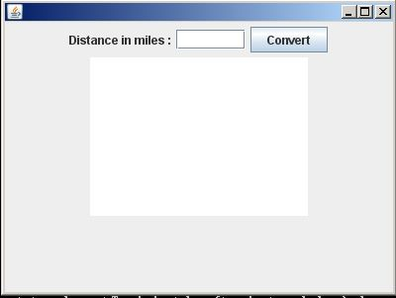
Implementing the Converter Class (Contd.).
Expected Output :

Slide 62
Implementing the Converter Class (Contd.).
Improved Version
------------------------
//add the following instance variables to the existing code
public int NBUTTONS = 12;
private JPanel keypadPanel ;
private JButton KeyPad[];
private String label[] = { "1","2","3",
"4","5","6",
"7","8","9",
"C","0","." };
public void initKeyPad(){
KeyPad = new JButton[NBUTTONS];
keypadPanel.setLayout(new GridLayout(4,3,1,1));
for(int k=0; k<KeyPad.length; k++){
KeyPad[k] = new JButton(label[k]);
KeyPad[k].addActionListener(this);
keypadPanel.add(KeyPad[k]);
}
}
Notes:
Note : While executing this code, an exception is thrown during runtime. The participants have to find the reason and take appropriate action so that the code executes successfully. Participants also have to ensure that they get the expected output.

Slide 63
Implementing the Converter Class (Contd.).
public Converter(){
getContentPane().setLayout(new BorderLayout());
initKeyPad();
JPanel inputPanel = new JPanel();
inputPanel.add(prompt);
inputPanel.add(input);
getContentPane().add(inputPanel,"North");
JPanel controlPanel = new JPanel(new BorderLayout(0,0));
controlPanel.add(keypadPanel, "Center");
controlPanel.add(convert, "South");
getContentPane().add(controlPanel, "East");
getContentPane().add(display, "Center");;
display.setLineWrap(true);
display.setEditable(false);
convert.addActionListener(this);
input.addActionListener(this);
}

Slide 64
Implementing the Converter Class (Contd.).
public void actionPerformed(ActionEvent e){
if(e.getSource() == convert || e.getSource() == input){
double miles = Double.valueOf(input.getText()).doubleValue();
double km = MetricConverter.milesToKm(miles);
display.append(miles + "miles equals " +km + "kilometers \n" );
input.setText(" ");
}
else{
JButton b = (JButton)e.getSource();
if(b.getText().equals("C")){
input.setText(" ");
display.setText(" ");
}
else
input.setText(input.getText() + b.getText());
}
}
}

Slide 65
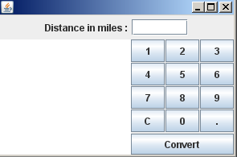
Implementing the Converter Class (Contd.).
Expected output :

Slide 66
Summary
In this module, you were able to:
Understand the need to develop GUI programming
Know the usage of different AWT containers and components
Define the need for event handling
Apply the Delegation Event Model
Define an Event Source and Event Listener
Describe event classes that encapsulate various kinds of events

Slide 67
Summary (Contd.).
In this module, you were able to:
Describe the process of a listener registering with an event source
Define adaptor classes, inner classes, and anonymous inner classes
Implement different event handling methods
Identify the need for creating platform-neutral GUI-based applications
Describe various controls and layout managers in Swing

Slide 68
References
Schildt, Herbert and Naughton, Patrick. Java 2: The Complete Reference. New Delhi: McGraw-Hill, 2002.
Walrath, Kathy and others. JFC Swing Tutorial, The: A Guide to Constructing GUIs. Ed 2. New Delhi: Prentice Hall, 2004.
Oracle (2012). The Java Tutorials: Components. Retrieved on 17 April, 2012, from, http://docs.oracle.com/javase/tutorial/uiswing/components/index.html
Notes:
68

Slide 69
References (Contd.).
Schildt, Herbert and Naughton, Patrick. Java 2: The Complete Reference. New Delhi: McGraw-Hill, 2002.
Walrath, Kathy and others. JFC Swing Tutorial, The: A Guide to Constructing GUIs. Ed 2. New Delhi: Prentice Hall, 2004.
Oracle(2012). The Java Tutorials: Components. Retrieved on 17 April, 2012, from, http://docs.oracle.com/javase/tutorial/uiswing/components/index.html
Notes:
69

Slide 70
References (Contd.).
Schildt, Herbert and Naughton, Patrick. Java 2: The Complete Reference. New Delhi: McGraw-Hill, 2002.
Walrath, Kathy and others. JFC Swing Tutorial, The: A Guide to Constructing GUIs. Ed 2. New Delhi: Prentice Hall, 2004.
Oracle (2012). The Java Tutorials: Components. Retrieved on 17 April, 2012, from, http://docs.oracle.com/javase/tutorial/uiswing/components/index.html
Notes:
70

Slide 71
Thank You
Notes:
71

